Slide 1

Breast Cancer Classification Analysis
Group Members
Myat Sanda Kuu (2207040008)
Kaung Myat (2207010008)
Phone Myat Paing (2211020007)
Kaung San Thar (2211020004)

Slide 2
Table of Contents
Load Data
Exploratory Data Analysis(EDA)
Modeling
Testing
Inference

Slide 3
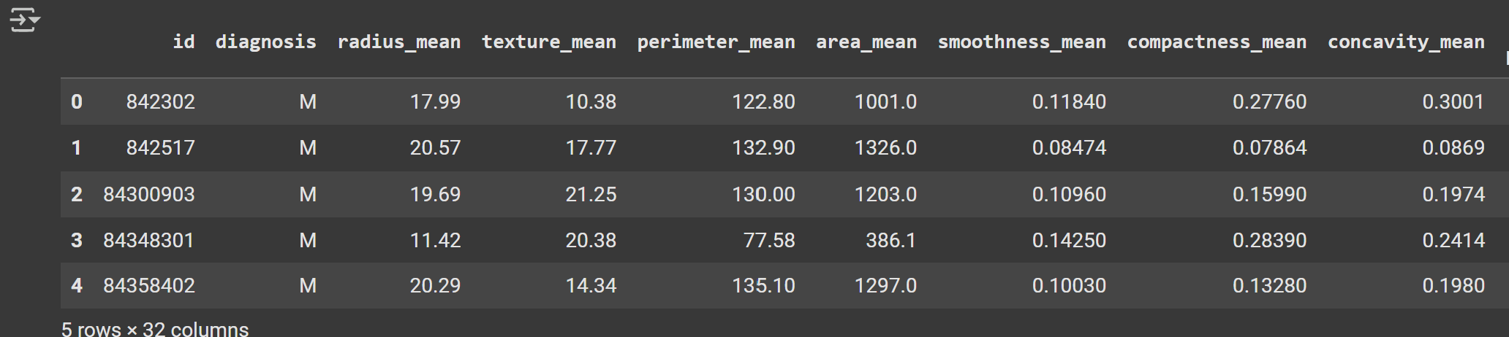
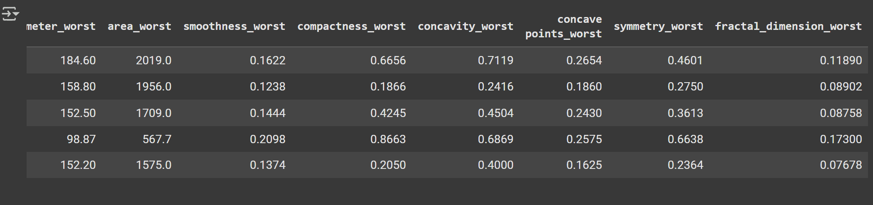
1. Load Data
# Display first few rows
df.head()

Slide 4
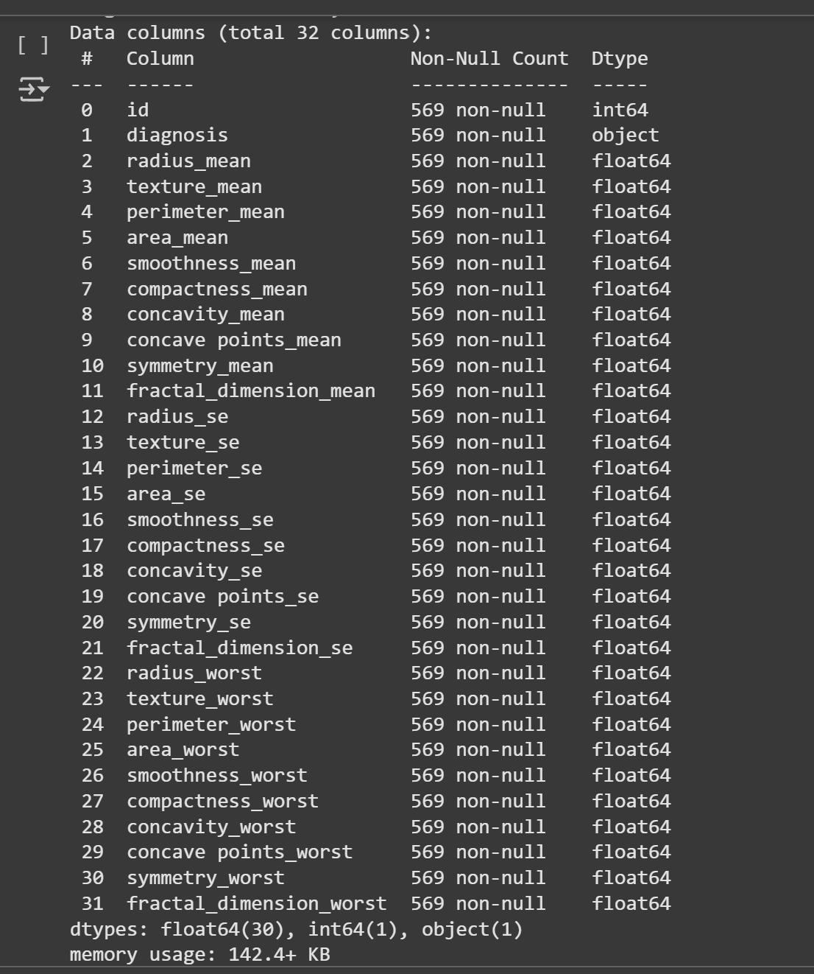
"Analysis of Cancer Dataset“
Overview of the dataset (569 records, 32 columns).
Purpose of the dataset (e.g., predicting cancer diagnosis).
df.info()

Slide 5
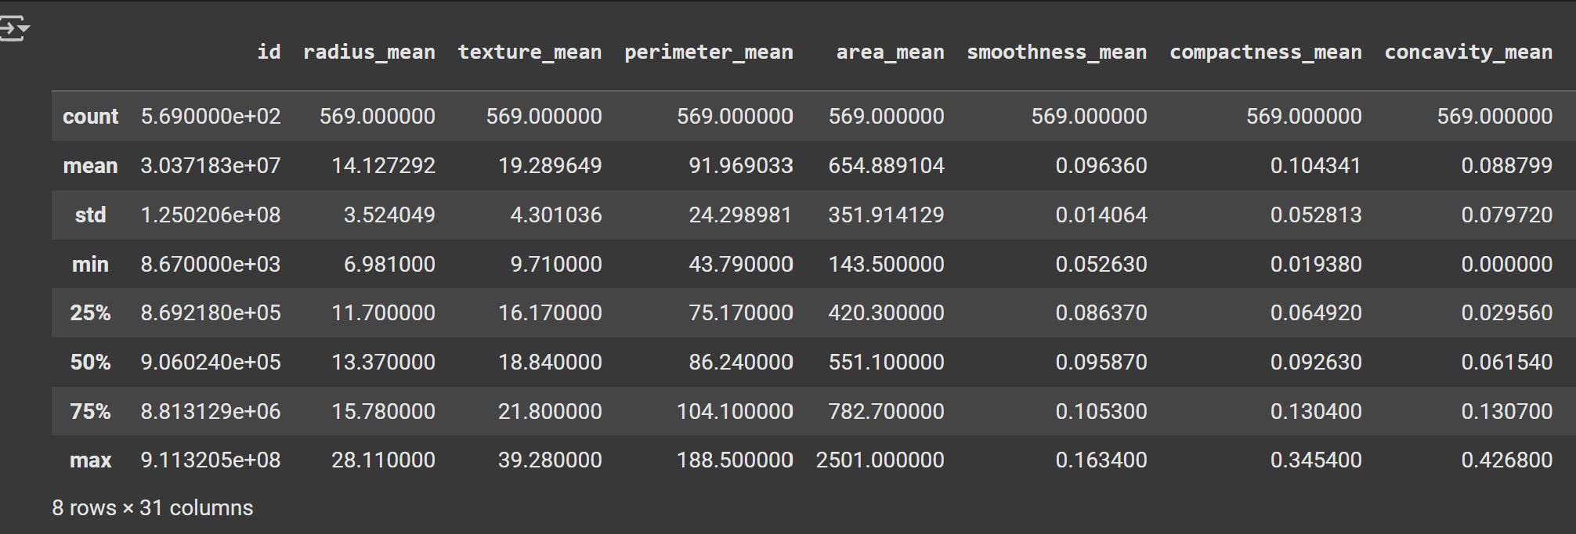
Descriptive Statistics
df.describe()

Slide 6
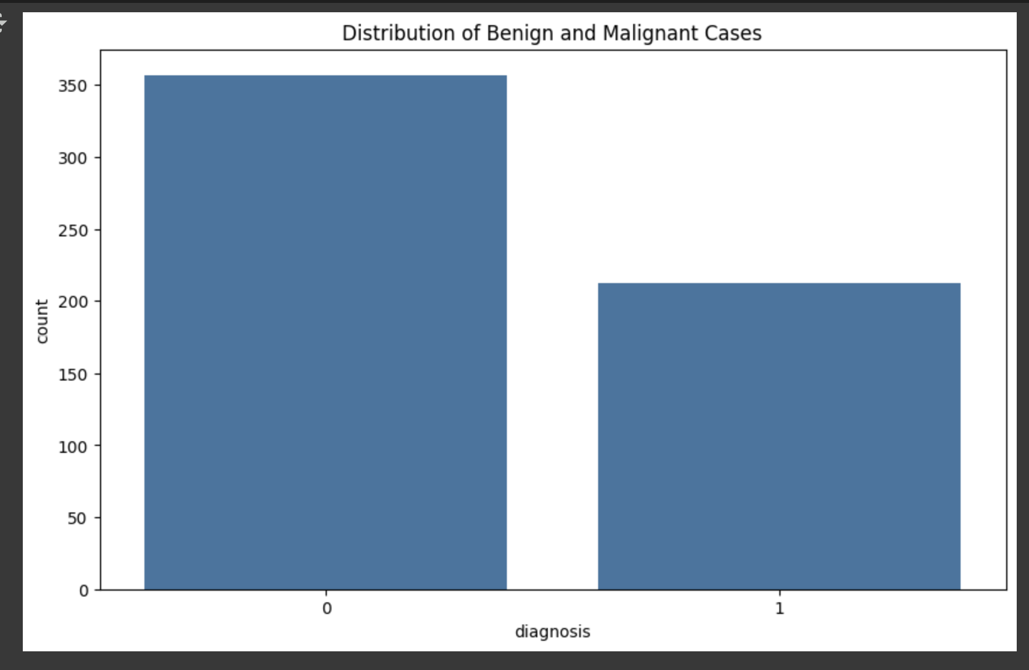
2. Exploratory Data Analysis (EDA)
Diagnosis Categories Bar Plot
0 (Benign): Representing non-cancerous cases.
1(Malignant): Representing cancerous cases.
Insights from the Chart:
Majority of the cases are Benign (0) with over 350 records.
Malignant cases (1) are fewer, with less than 200 records.
The dataset is imbalanced, requiring attention during model training to prevent bias.

Slide 7
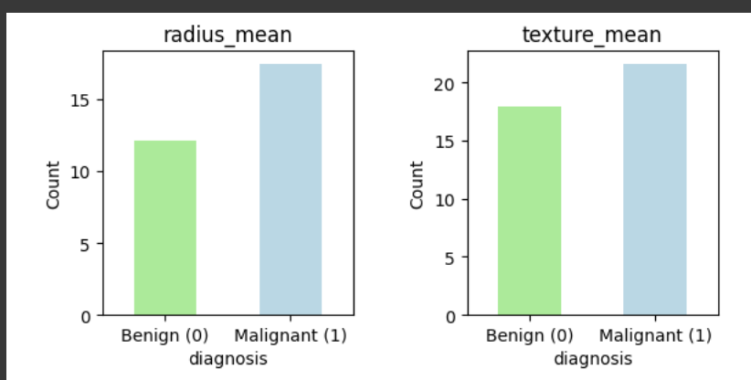
Analysis of Features by Diagnosis
Displaying the mean values of features

Slide 8
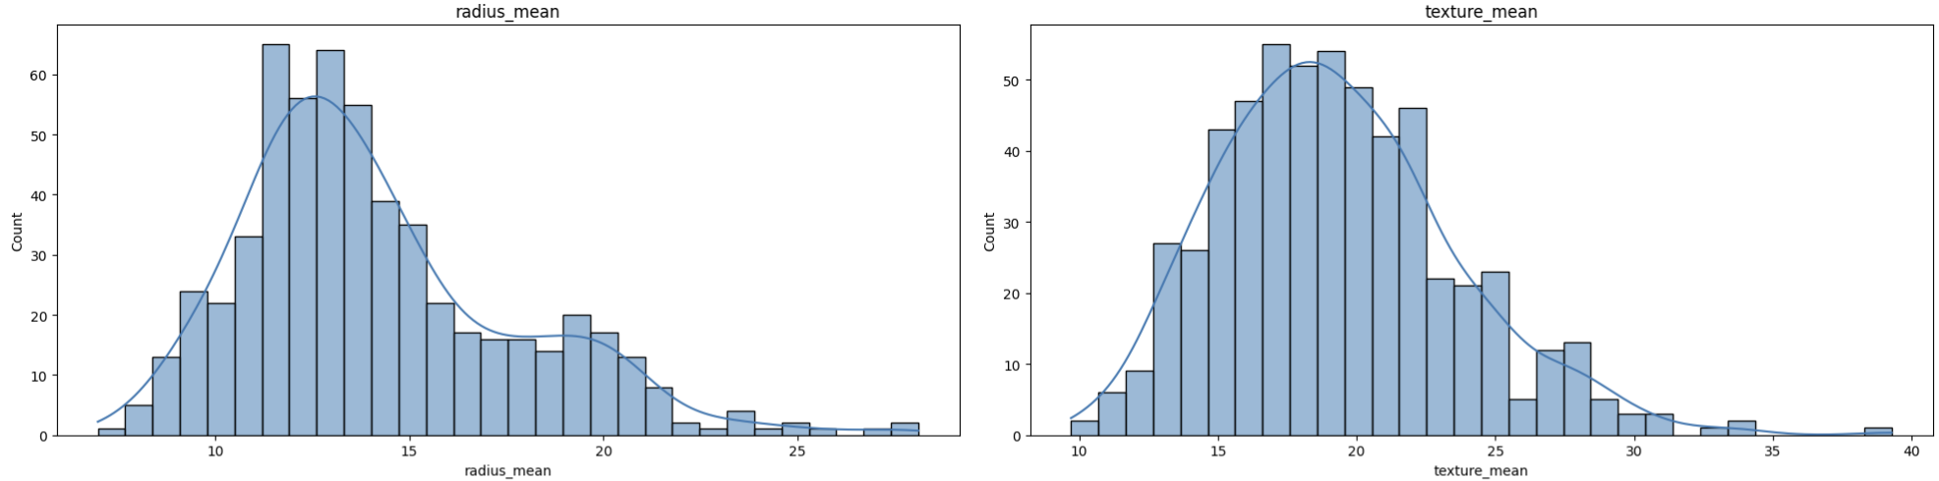
Histograms
Visualize the distribution of key features.
Radius Mean: Displays the frequency distribution of radius measurements.
Shows a skewed distribution with a peak around 15.
Texture Mean: Illustrates the texture measurements.
Exhibits a more uniform distribution with a slight peak around 20.

Slide 9
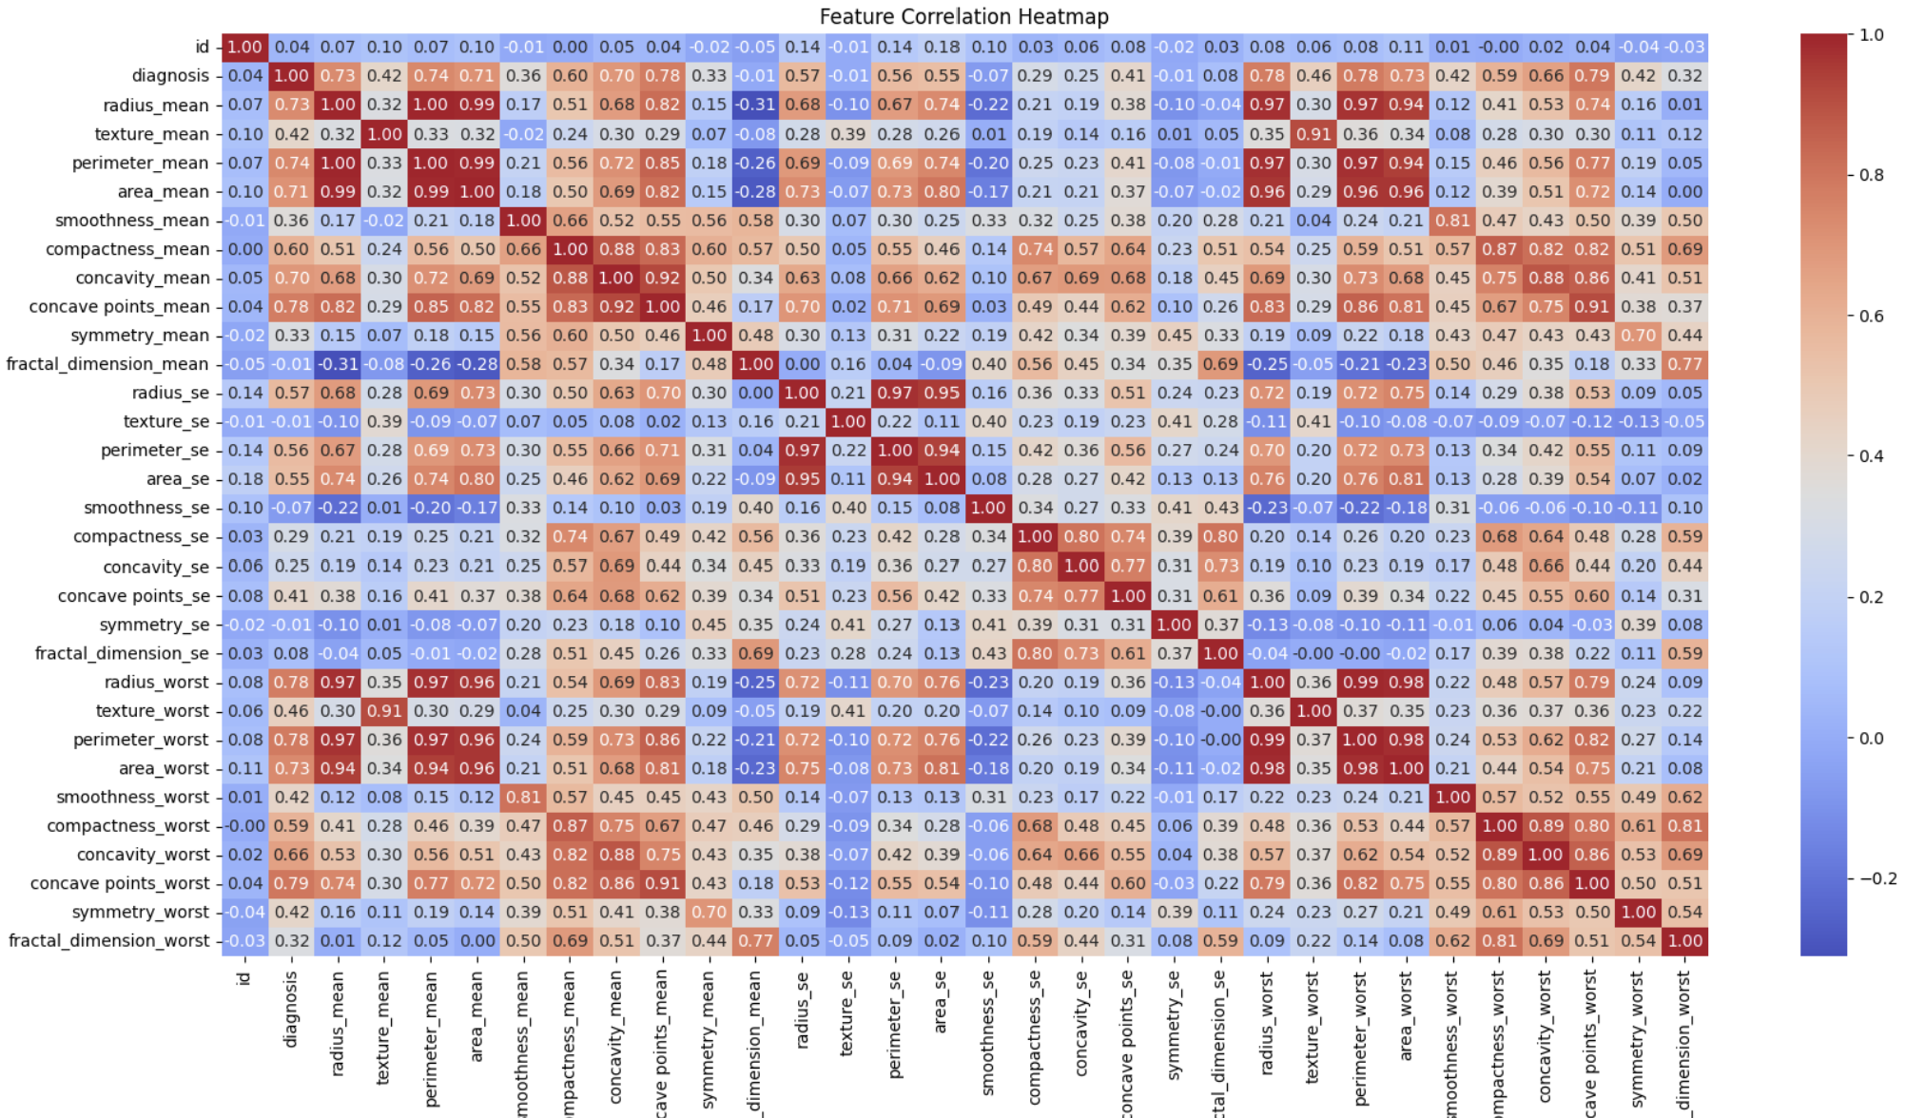
Correlation Matrix
Analyze relationships between features

Slide 10
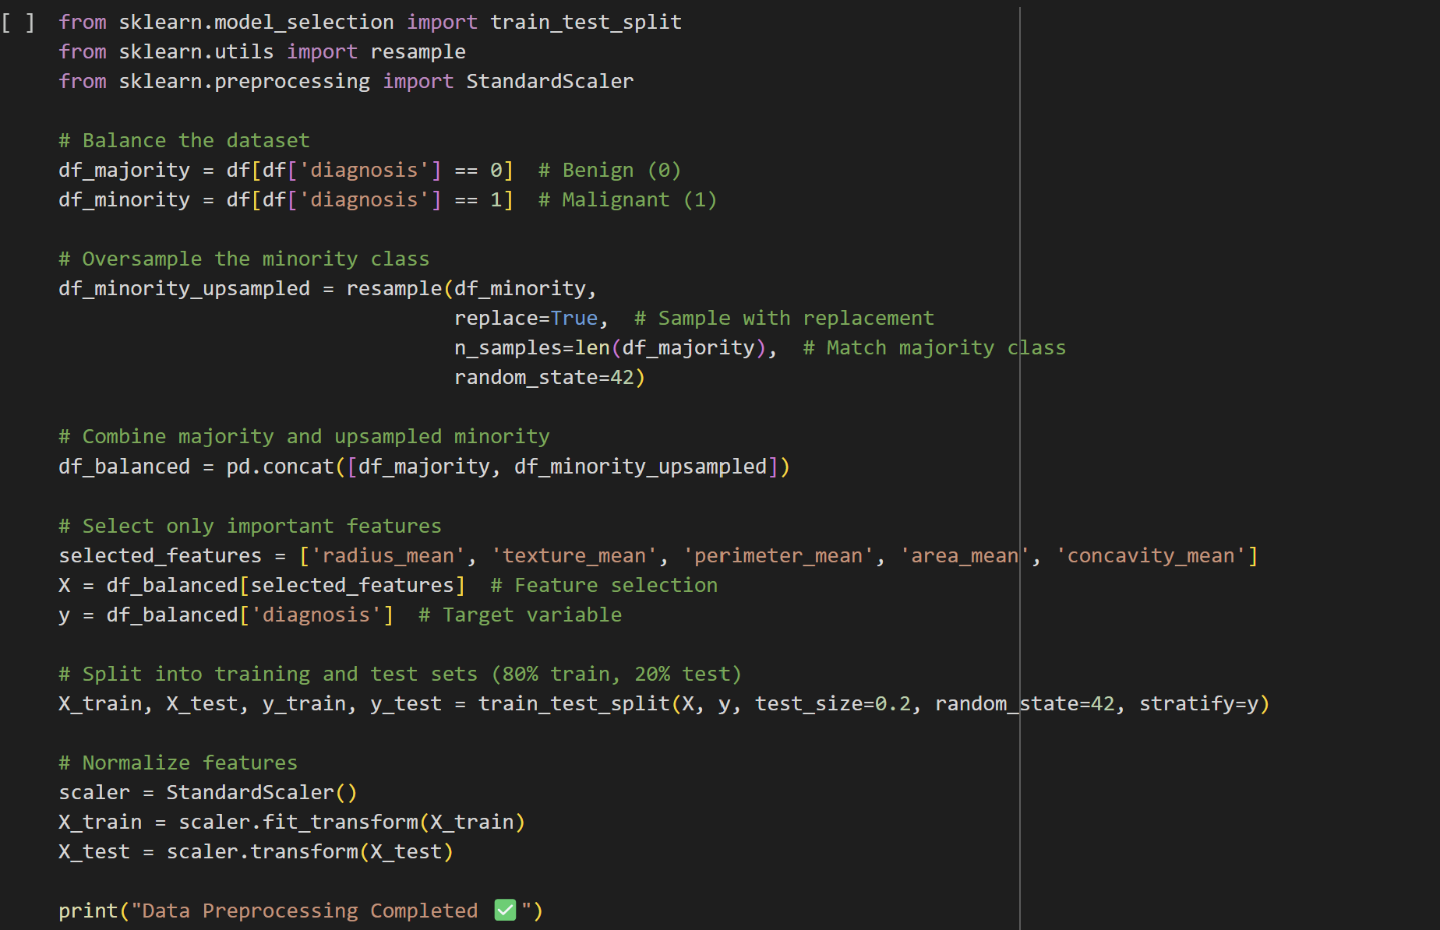
3. Data Preprocessing

Slide 11
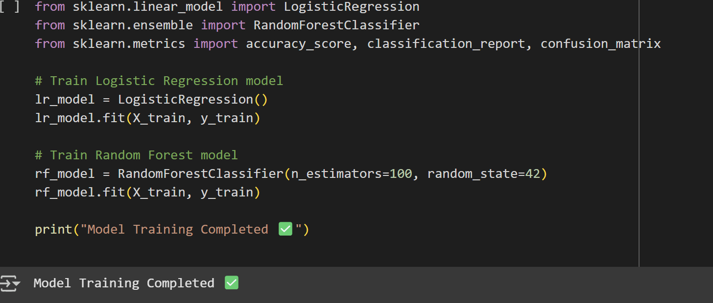
4. Modeling (Logistic Regression & Random Forest)

Slide 12
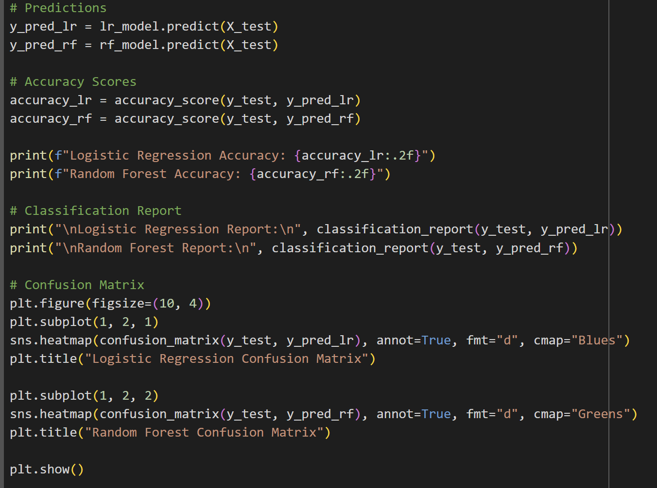
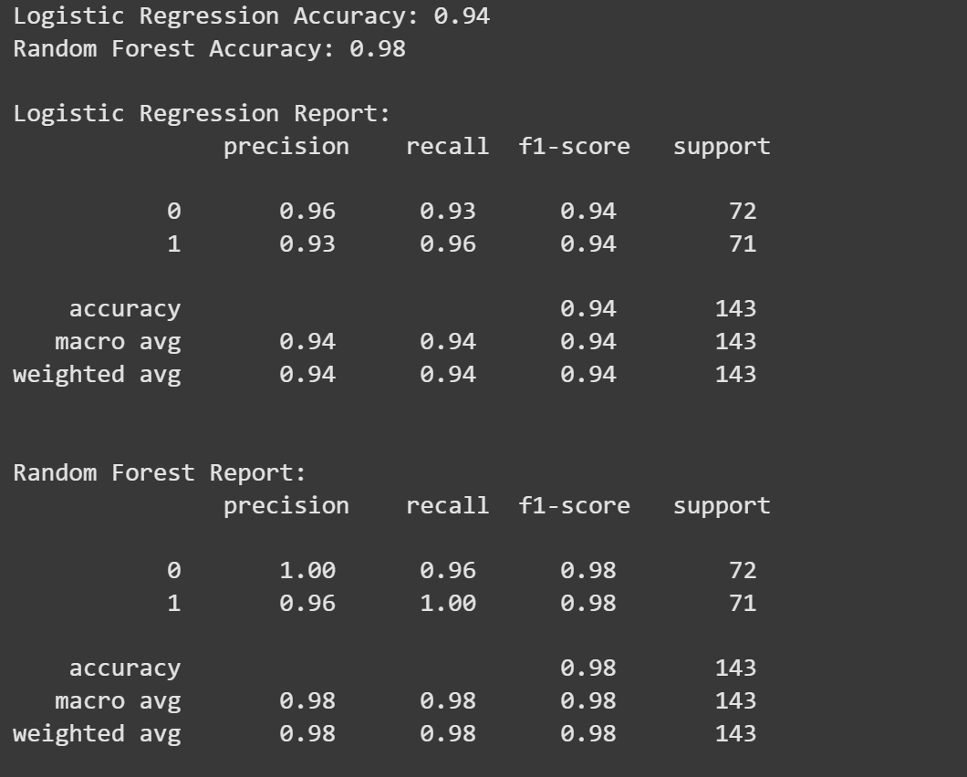
5. Testing (Evaluating the models)

Slide 13
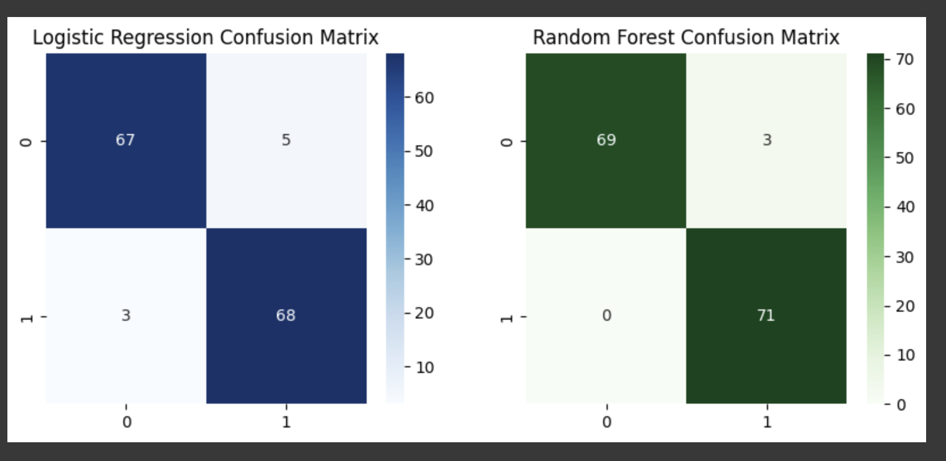
Model Performance Comparison

Slide 14
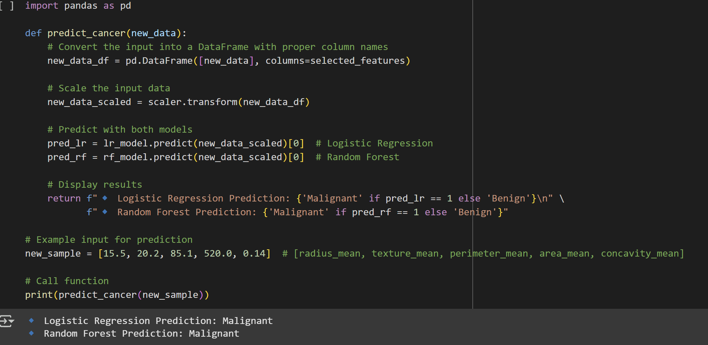
6. Inference

Slide 15


